Slide 1
Interpretation and
Model Checking in
First Order Logic
Fundamentals of Artificial Intelligence
Slides are mostly adapted from AIMA and MIT Open Courseware

Slide 2
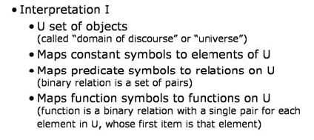
FOL Interpretations
Notes:
Let U be universe, corresponding to the set of objects in a domain
An interpretation I maps
Constant symbols to the elements of U
Predicate symbols to relations on U
And fu
nction symbols to functions on U

Slide 3
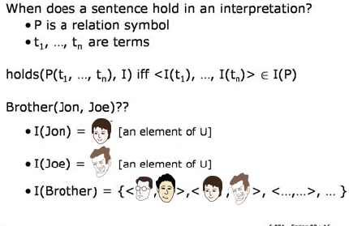
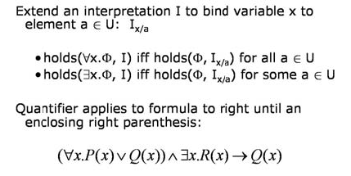
Holds
Notes:
Assume a universe consisting of the faces shown here
Interpretation of John in this universe is this young boy
and Joe is the man with curly hair
For Brother(Joe, John) relation to hold in this domain, we should have a tuple in brothership relation corresponding to the interpretation of Joe and John
In this case, we have
Let I x/a means to bind a variable x to a vale a from the domain U under an interpretation I
For all x, Fi holds iff for all a in U fi is true with Ix/a
There exist an x, Fi holds, ifff for some a in U fi is true with Ix/a

Slide 4
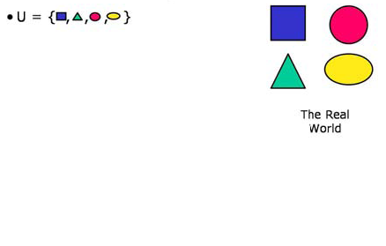
Example Domain
Notes:
Let’s consider a simple example to understand the meaning of interpretations in FOL
Our domain/universe consists of four objects

Slide 5
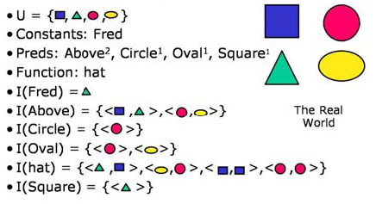
Example Domain
Notes:
There is a constant Fred that refers to the green triangle
Above predicate holds for two relations
{Blue square, Green triangle} and {red circle, yellow oval}
Circle predicate holds for red circle
Oval holds for red circle and yellow oval
Hat is a function
Where hat of green trianle is blue square, hat of yellow oval is red circle, hat of blue square is blue square and hat of red circle is red circle
Square holds for green triangle.
Note that, the interpretations are upto us. So this is possible

Slide 6
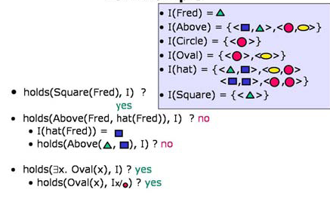
Example Domain
Notes:
Under these interpretations let’s try to answer a few questions
Does square(fred) holds under this interpretation.
Or in short, considering the interpretation I
Is square(Fred) true?
To answer this question we will look at our interpretations shown on the left as a reminder
The interpretation of Fred is green triangle and square predicate holds for green triangle
So it is true
Let’s try holds(above(fred, hat(fred))
Interpretation of fred is green triangle and interpretation of hat(fred) is blue square in this universe
So, we look for whether the above(green triangle, blue square holds) in this interpretation
But this time it does not hold
Note that above(blue square, green triangle) is different
What about thereixists an oval(x)
To test this sentence we will check for every possible interpretation of x
And one is enough
At our first try with red circle we showed that this sentence holds in this universe/domain

Slide 7
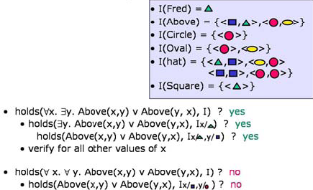
Example Domain
Notes:
Let’s consider more complex sentences
The first sentence is :
For all x there exists a y where x is above y or y is above x
We have to verify it for every x, triangle, circle, square and oval
But for each of them it is sufficient to show that at least for one y it is true
For triangle it is true for square. And symmetrically for the square it is true for triangle
For circle it is true for oval. And symmetrically for the oval it is true for circle
So the entire sentence is true
On the other hand when we change there exists a y with for all y
The sentence is false
for example for x being square and y being circle it is false
For all requires it to hold for everything and it is false even if a single one is false

Slide 8
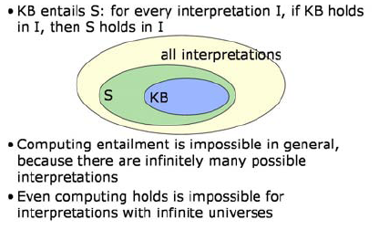
Entailment in First Order Logic

Slide 9
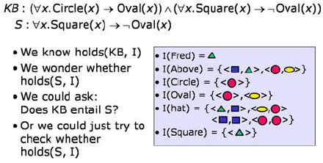
Intended Interpretations

Slide 10
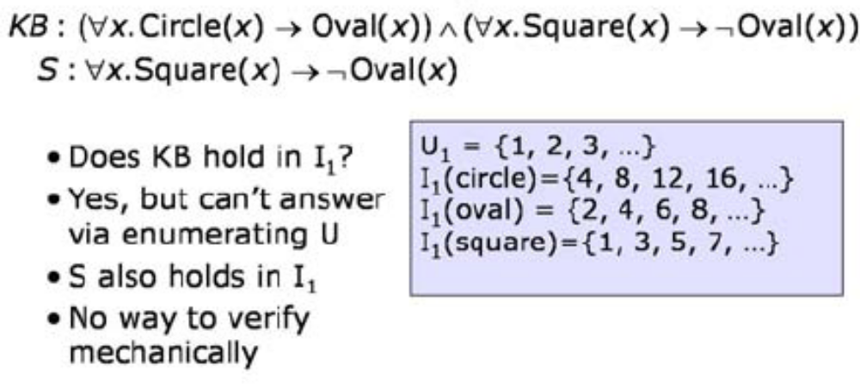
An Infinite Interpretation

Slide 11
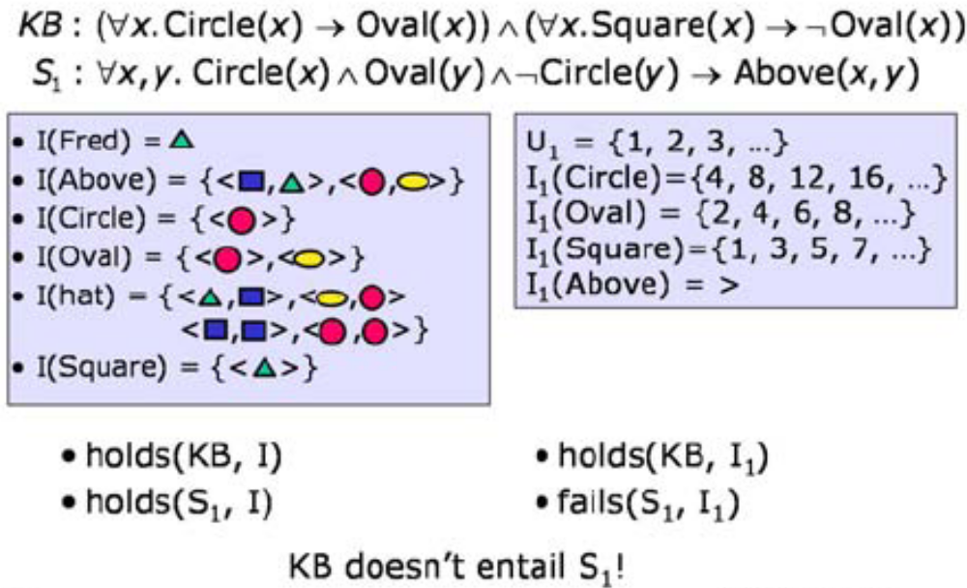
An Argument for Entailment

Slide 12
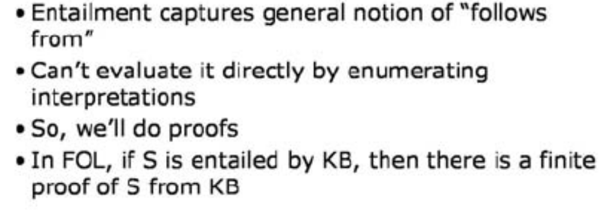
Proof and Entailment

Slide 13
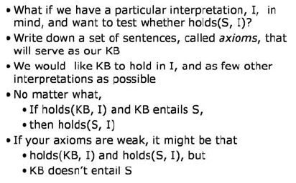
Axiomatization

Slide 14
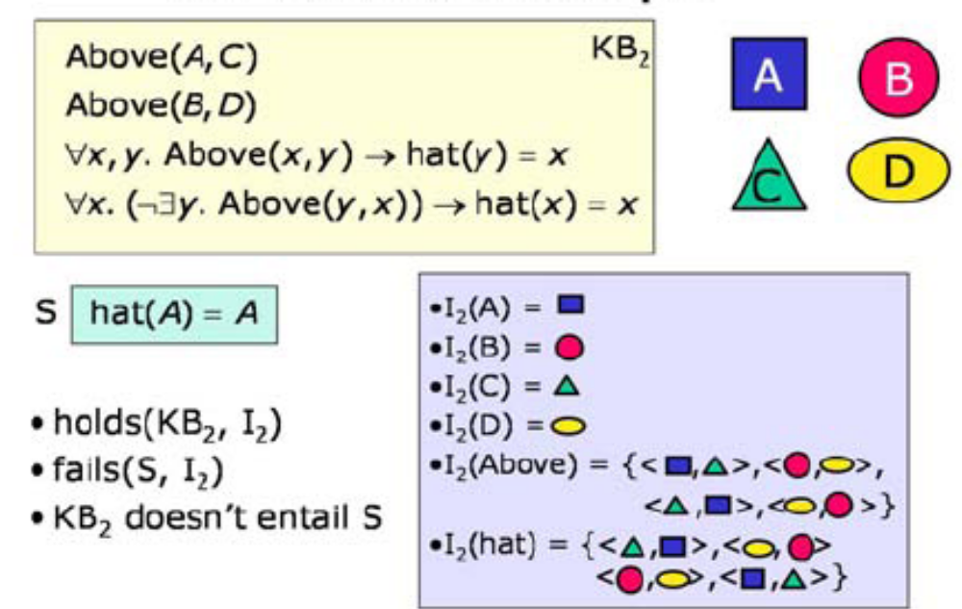
Axiomatization Example

Slide 15
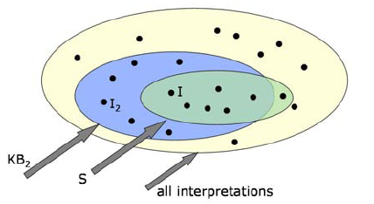
KB2 is a Weakling!

Slide 16
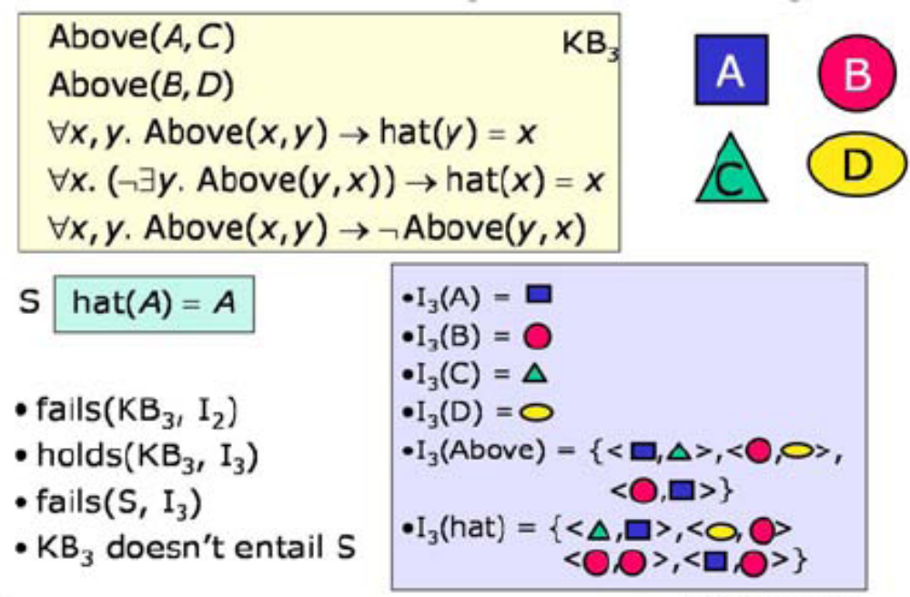
Axiomatization Example: Another Try

Slide 17
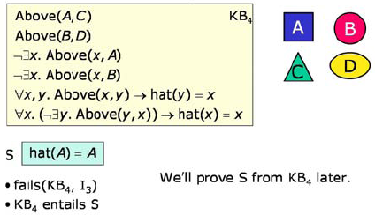
Axiomatization Example: One last time

